Slide 1
CDS Evaluation
Module — Creating a Simplified Model of Work
Notes:
Instructor and learner introductions

Slide 2
Module Objectives
By the end of this module, you will be able to:
Define work context
Differentiate current state vs. future state
Describe and list several work models
Differentiate mental vs. conceptual model
Understand the work modeling process
Complete a value proposition
Conduct informal user interviews

Slide 3
Creating a simplified Model of Work
What are Work Models?
Collect Background Information
Define Value Proposition
Conduct Informal Interviews
Create Workflow Diagram
Identify Key Goals, Decisions, and Tasks

Slide 4
Key Work Factors Determining Work Context
System quality and usability emerges from the optimization of key work factors to solve a business problem
A good evaluation plan identifies and prioritizes key work factors and which combinations are relevant to the business goals
Work Context
User
Task
Technology
Environment
Of Use
Teamwork

Slide 5
Current State vs Future State
CDS interventions are most likely to change
Tasks
Technology
Teamwork
For example: a new CDS tool represents a change in technology used to perform a clinical task. New technology is intended to improve performance or outcomes for a specific task. Changes in an individual’s task often change the workflow for the care team.
CDS evaluation of the current state can be used to compare the utility of the intended future state

Slide 6
Models of work
Health Care is among the most complex work domains to evaluate
We use models and modeling to organize project knowledge, simplify analysis, and guide creation of an evaluation plan
Modeling is the practice of representing complex and abstract phenomena along particular dimensions to simplify and aid understanding Hartson and Pyla, p41.

Slide 7
Types of Work Models
Core Models
User Role: demographics, skills, attitudes
Task: goals, decisions, techniques, processes
Technology: platform, software, artifacts
Environment of Use: location, time, situation
Teamwork: communication, cooperation, workflow
Composite Models
Designer’s Conceptual Model – how the designer expects the system to be perceived and used
User’s Mental Model – how the user actually perceives the system
Notes:
See Hartson 2ed, p41 for Modeling
Hartson 2ed, p177, Usage Research Data Modeling
Cooper, 4ed, p 61, Modeling Users: Personas and Goals
Beyer & Holtzblatt, 1998, p89, Work Models

Slide 8
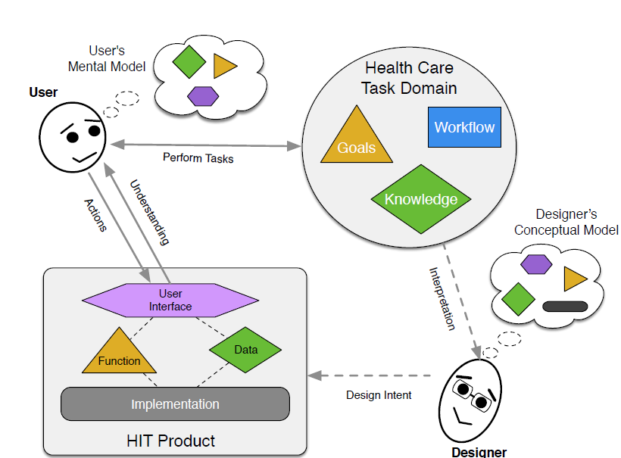
Conceptual Models in Health Care
Adapted from Conceptual Models (Johnson and Henderson, 2012)
Notes:
Scott:
To avoid mismatches, we must achieve shared understanding of all usage factors
Users and designers have different perspectives for how an application should be used. A conceptual model captures designer intent explicitly and permits patient safety analysis.
Users develop a mental model based on their background and available functionality.
Designers derive a conceptual model for how the product should be used based on their understanding of the domain.
Latent design issues (Reason, 1997) can arise from mismatches between the mental and conceptual models (Norman, 1988), which can result in patient safety risks (Chapman et al., 2012).
[ ] ended at :29
[ ] User Mental Model > Conceptual Model < Designer Mental Model
[ ] Iterate the graphic

Slide 9
Example questions to model Work
Medical Task Domain
Medical Basis
What medical need is being addressed?
How does app meet the health care need?
Information
Is content accurate and written for the user?
Where does the information come from and when was it last updated?
Tasks & Activities
Tasks/Decisions
Which tasks & decisions does app support?
Does design support tasks & decisions?
Are consequences of actions clear?
How does product handle errors?
Concepts/Features
What app concepts support the tasks?
How to concepts relate to tasks?
Users
Types
Who are the users and why do they need the product?
Which provider types will use the product
Background
Will user be able to understand how to use product & content?
Does the product assume specialized training?
Environment of Use
Location
Where will the product be used?
Support
How does the user get help or report problems?
Teamwork
Workflow
With whom and how are users interacting with other people or systems?
Technology
Devices/Application/Supplies
What technology or supplies are needed for the work?

Slide 10
Collect Background Information
The CDS business owner should be able to provide answers to scope and guide the evaluation
Project charter, project goals
The CDS developer should be able to provide details for question #4 (the proposed solution)
Project plan, user documentation
Caution: business owner and developer perceptions may not be fully accurate!
Start with drafting the business owner’s value proposition

Slide 11
Value Proposition
A value proposition is a promise of value to be delivered, communicated, and acknowledged. It is also a belief from the customer about how value (benefit) will be delivered, experienced and acquired. [Wikipedia]
A value proposition connects CDS evaluation with goals of the business owner
The ability to accomplish business goals helps us determine if the right CDS tool was built
The ability of people to use the CDS tool helps us determine if tool was built right
Notes:
Source: https://en.wikipedia.org/wiki/Value_proposition, 4/10/2020.
See Roberts, M.S. (2006). Economic Aspects of Evaluation. In Friedman, C.P. and Wyatt, J.C. Evaluation Methods in Biomedical Informatics. Chapter 11, pg. 304. New York: Springer.

Slide 12
Key Questions to Form the Value Proposition
What problem is the CDS tool intended to solve?
Who does the problem affect and how is it quantified?
What is currently done and why is it not good enough?
What is the proposed solution and how does it overcome the problem?
How will you measure success?
How does it benefit Veterans?

Slide 13
Value Question: What’s the Problem?
Start with a simple problem statement
Emergency Medicine Documentation Template(EMDT) Example:
Lack of standardization of Emergency Medicine clinical documentation leads to inconsistent data in the patient record; this leads to inefficiencies in accessing needed data and inefficient communication across care team and inefficient clinical decision making.
The problem statement scopes the evaluation to a particular domain, task type, and limited set of clinical decisions
Notes:
What problem is the CDS tool intended to solve?

Slide 14
Value Question: Who Does it Affect and How?
Start by listing who might be affected by the problem?
EMDT Example:
Emergency Medicine clinicians creating documentation and making decisions specific to patient treatment in the Emergency Department
Clinicians following up on ED care, making decisions based on the documentation
Veteran patients receiving ED care
Veterans who could receive care if additional resources were available

Slide 15
Value Question: Who Does it Affect and How? (continued)
For each listed role, briefly describe how they are being adversely affected
EMDT Example:
ED Clinicians – Current documentation practices do not adequately describe key clinical decisions
Recipient Clinicians – Poor documentation prevents optimal follow-up care
ED Patients – Poor documentation leads to worse outcomes
Other Veterans – Poor documentation leads to poor workload capture, reducing resources to care for other Veterans.

Slide 16
Value Question: What’s the Current Solution?
Briefly describe the process or technology currently used for the clinical decisions?
Build on the problem statement and affected roles by adding causal elements for why the current solution allows suboptimal outcomes
EMDT Example:
VAMCs use local templates with wide variability in workload capture, codability, usability, usefulness to subsequent readers of the note. This makes it more difficult to:
find patient/treatment information afterwards
apply automation to some information
difficult to accommodate different documentation styles
Notes:
How is the problem currently being addressed? Why is the current solution not adequate? The answers to this question build on the prior question to address general process-level barriers that cause the issues for the identified roles within the scope of the problem statement.

Slide 17
Value Question: What’s the Proposed Solution?
Use the new CDS intervention to describe the contrasting elements of the new or proposed solution
How does the new CDS change the work?
What’s new about the decision process, the information used, or the resulting artifacts?
EMDT Example:
Develop a national clinical reminder template that:
Meets national standards for patient care.
Supports the standardization of clinical data.
Accommodates differences in acceptable documentation styles.

Slide 18
Value Question: How IS Success Measured?
Use the problem statement to identify initial measures and metrics of specific interest to the goals of the business owner.
Document all key measures even in they are difficult to assess directly (e.g., patient outcomes)
Consider how the subgoals of work roles contributing to the business goal and how they may be measured.
Consider indirect measures that may indicate improvement in the CDS process

Slide 19
Success Measures Example
Example: Consider EMDT problem statement
Lack of standardization of Emergency Medicine clinical documentation leads to inconsistent data in the patient record; this leads to inefficiencies in accessing needed data and inefficient communication across care team and inefficient clinical decision making.
Some measures to consider from this:
Standardization of resulting notes.
Quality of resulting notes.
Reduced clinician time spent on documentation.

Slide 20
Value Question: How does it benefit Veterans?
Veterans are the most important factor in considering CDS value.
Even if none of the primary measures directly addresses Veterans, ensure that assumptions of value are made explicit.
EMDT Example:
Improved patient outcomes (healthier Veterans).
Increased patient throughput (more Veterans treated).
Improved patient satisfaction (Veterans perceive better care).

Slide 21
Interview Primary CDS User Role
Conduct informal interview of primary CDS user role
Capture user’s answers to value proposition questions
Ask about any discrepancies
Establish user’s goals, work process, success criteria
What clinical task are you doing when you use the CDS?
What clinical decision is being supported?
Where do you get information to make that decision?
How does the As-Is system support or not support that decision?
How should the To-Be system support that work?
Where and how does your decision get documented or shared?
Who reads the results? Do they ever ask clarifying questions?
Can you describe any critical incidents that have occurred with the As-Is system?
How do you expect the To-Be system to help improve your work?
Sanity check: does the user’s perspective correspond to the value proposition?
If not, clarify or revise the value proposition – review with business owner
If major discrepancy, business owner must reconcile the issue
Notes:
See interview discussion Mod3, slide 20
A phone interview may be sufficient if in-person is not feasible.

Slide 22
Conduct Other Informal Interviews
Interview all other work roles within the scope of the proposed CDS solution
Primary users of the CDS
Roles supplying information for the CDS
Roles receiving the output of the clinical decisions
Roles evaluating clinical performance of the primary users
Supervisors, quality improvement, patient safety
Sanity check: do the roles listed correspond to those in the value proposition?
If not check pare down the list or adjust the value proposition
Notes:
See interview discussion Mod3, slide 20

Slide 23
Identify Key Goals, Decisions, and Tasks
For each of the work roles
Describe your role in the process and the team
What are the smaller goals each role is responsible for to solve the business problem?
What processes or tasks are used to achieve those goals?
What triggers a goal? How do they know when to start?
What equipment is needed to perform the tasks?
How does their work relate to the the CDS tool?
Provides information for the CDS
CDS user or decision maker
Recipient of CDS results
What indicates that a goal has been successfully completed?
What makes your work hard to do in the As-Is system?

Slide 24
Summary
Creating simplified models of work helps us understand the evaluation problem
The Value Proposition is the starting point to scope and guide the evaluation process
Key areas of information to gather
User roles
Tasks
Technology
Environment of Use
Teamwork
Next step: Creating a Workflow Diagram

